Slide 1

“Teamfight Tactics” made by Riot Games
CSE 111 Project
By Kenneth Tran &
Ankan Bhattacharya

Slide 2
System Description
Database of TFT (Teamfight Tactics)
Information of characters, items, etc.
Optimizing item selection for a character
Finding the best compositions sorted by win rate and average placement
Notes:
A specification of the project requirements. This should describe the main use cases

Slide 3
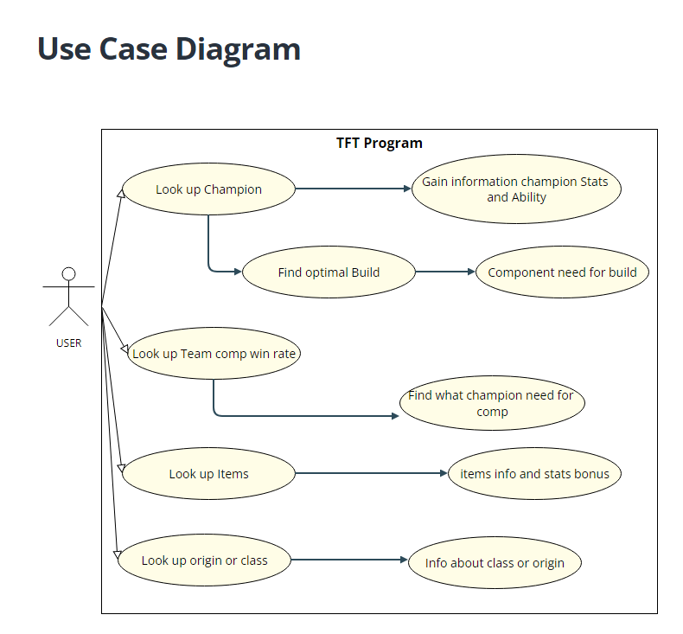
UML Use-Case Diagram
Notes:
You have to draw a UML use case diagram and write plain text describing the main use cases

Slide 4
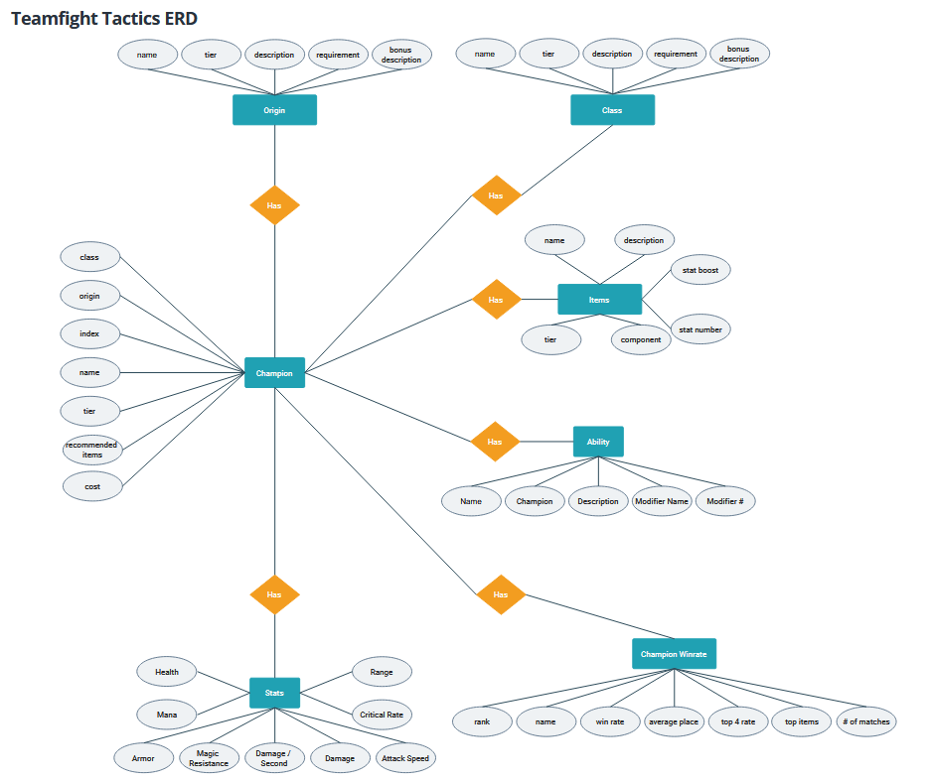
E/R Diagram & Schema
Notes:
You have to draw a UML use case diagram and write plain text describing the main use cases

Slide 5
Implementation Details
Storing database by SQL and searching through it.
Create a web page for user to interact using the React framework
The frontend and backend will interact through Python Flask
Search bar for look up champion or items
Include graphics for champion, items, traits, etc.
Tell user if the champion is good/bad by tier list.
Recommend what item to prioritize first.
Notes:
E/R Diagram

Slide 6


Thank you!
And do it for Choncc
Notes:
Relational Schema

